Slide 1

Orbital Introduction to Databases
Vo Hoang Tam
School of Computing
National University of Singapore
voht@comp.nus.edu.sg
Photo Credit: tec_estromberg

Slide 2
Outline
Recap Google Datastore
Introduction to Databases
Exercises on Database design and SQL
SQL vs. NoSQL

Slide 3
Google Datastore (recap from Lift-off session on GAE)

Slide 4
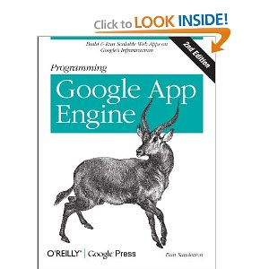
Datastore
Add item to wish list:
Item url:
Image url:
Item description
Submit
Wish List
Item
I am looking for a book on Google App Engine …
Notes:
Read the form and insert into datastore
Read from the datastore and display in table
For this section we will work from the giftbook directory

Slide 5
Data Model
App Engine uses a hierarchical data model
Datastore definition in giftbook.py
class Persons key: leews@comp.nus.edu.sg
next_item: 2
…
…
.
item_id: 1
item_link: http://…
description: I am looking for a book on Google App Engine…
image_link: http://…
class Persons(ndb.Model):
# Models a person. Key is the email.
next_item = ndb.IntegerProperty()
key: 1
date: …
class Items(ndb.Model):
# Models an item with item_link, image_link, description, and date. Key is item_id.
item_id = ndb.IntegerProperty()
item_link = ndb.StringProperty()
image_link = ndb.StringProperty()
description = ndb.TextProperty()
date = ndb.DateTimeProperty(auto_now_add=True)

Slide 6

Consistency
Use ancestor queries if you need consistency
ndb datastore is only eventually consistent (why?)
Try changing
query = ndb.gql("SELECT * "
"FROM Items "
"WHERE ANCESTOR IS :1 "
"ORDER BY date DESC",
parent_key)
to
query = ndb.gql("SELECT * "
"FROM Items ”)

Slide 7
Other Problems
Data redundancy
costly writes (as a trade-off for scalability and fast reads)
Limited application scenarios
key-value and hierarchical model

Slide 8
Introduction to Databases

Slide 9
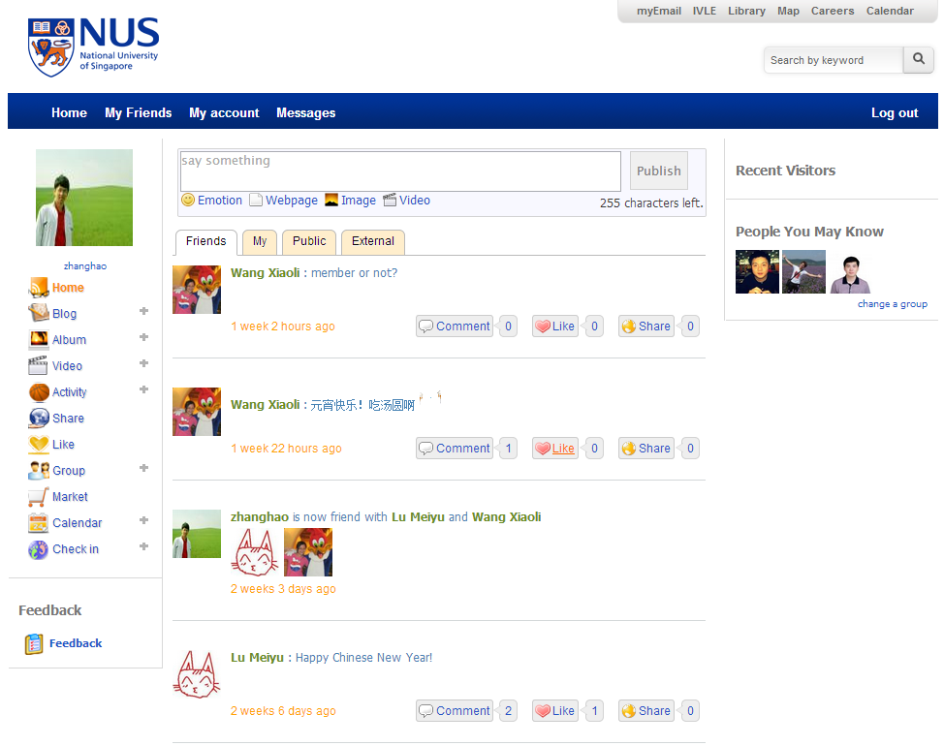
Database – backend for modern apps
Social networking
Facebook
Why Facebook uses MySQL for Timeline
Facebook shares some secrets on making MySQL scale
NUS Life -- https://life.nus.edu.sg/
Online games
MMOG – Massively Multiplayer Online Games
Notes:
Have you ever wondered where all the information like user profile, friendlist, post, notes are stored….
It is challenging to develop the database engines that are needed to run a successful MMOG with millions of players

Slide 10
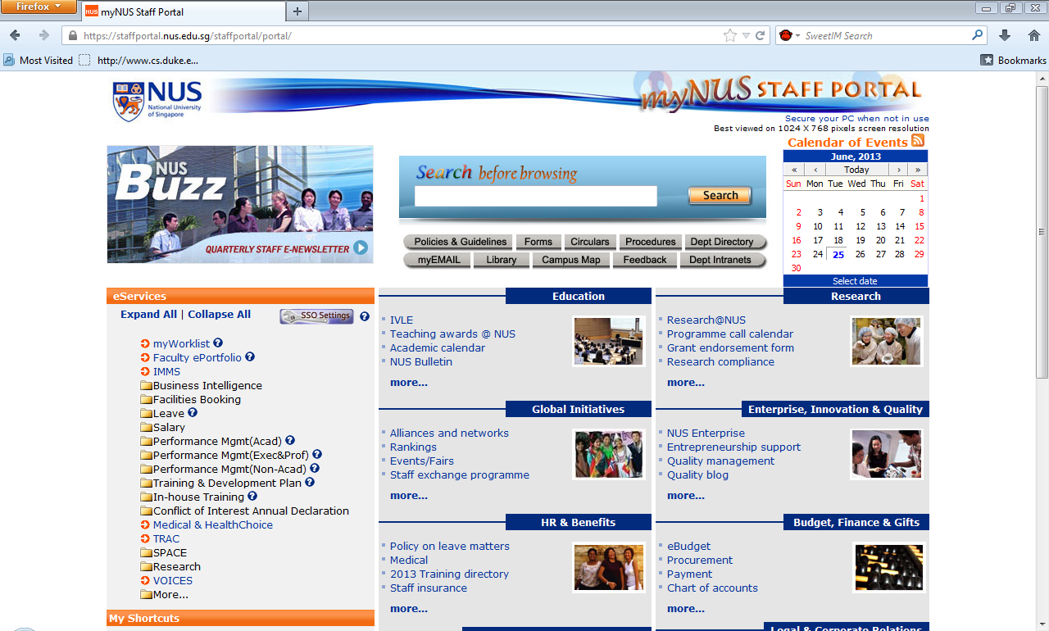
Database – backend for modern apps
Enterprise apps

Slide 11
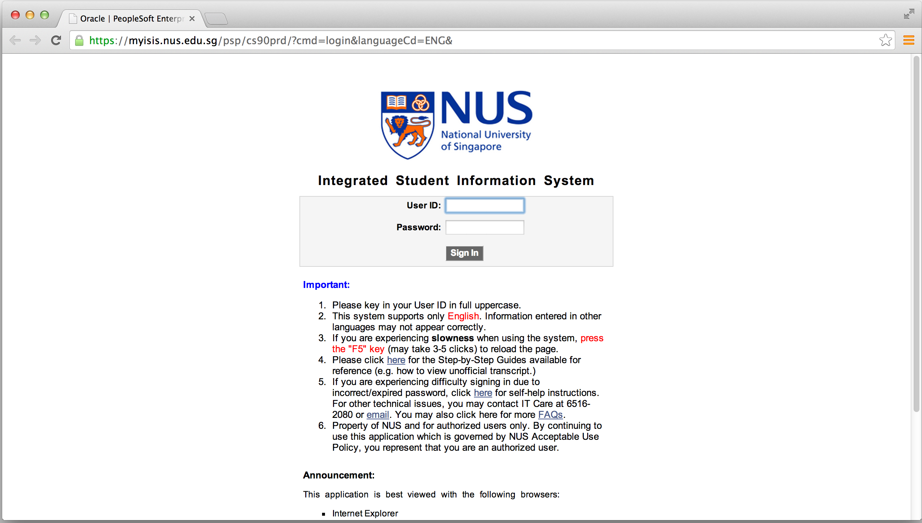
Database – backend for modern apps
Enterprise apps

Slide 12
Database Design
Ensure final product meets requirements
Focus on data requirements
Sub-phases
I. Create conceptual design
II. DBMS software selection
III. Create logical design
IV. Create physical design
Notes:
Make sure

Slide 13
I. Conceptual Design
Create abstract data structure to represent real-world items
Steps
Data analysis and requirements
Entity relationship modeling and normalization
Data model verification
Notes:
Data modeling
High level of abstraction

Slide 14
Data analysis and Requirements
Focus on
Information needs
Information users
Information sources
Data sources
Developing and gathering end-user data views
Direct observation of current system
Interfacing with systems design group
Notes:
Business rules

Slide 15
Data analysis and Requirements: e.g., data requirements for a retailer
A retailer operates in several cities. A city is identified by its name and the state it belongs to. In a city there is one headquarter coordinating the local operations.
A city may have several stores. Data regarding to a store include its identifier (id), address and the manager’s id.
Stores hold any amount of items. The information of an item (its id, description, size and color) are recorded in the database.
The system also needs to maintain the information of customers including customer number, address, phone number and customer name.
Customers place their orders which include any number of items to a given store. The order number and order date are also recorded.

Slide 16
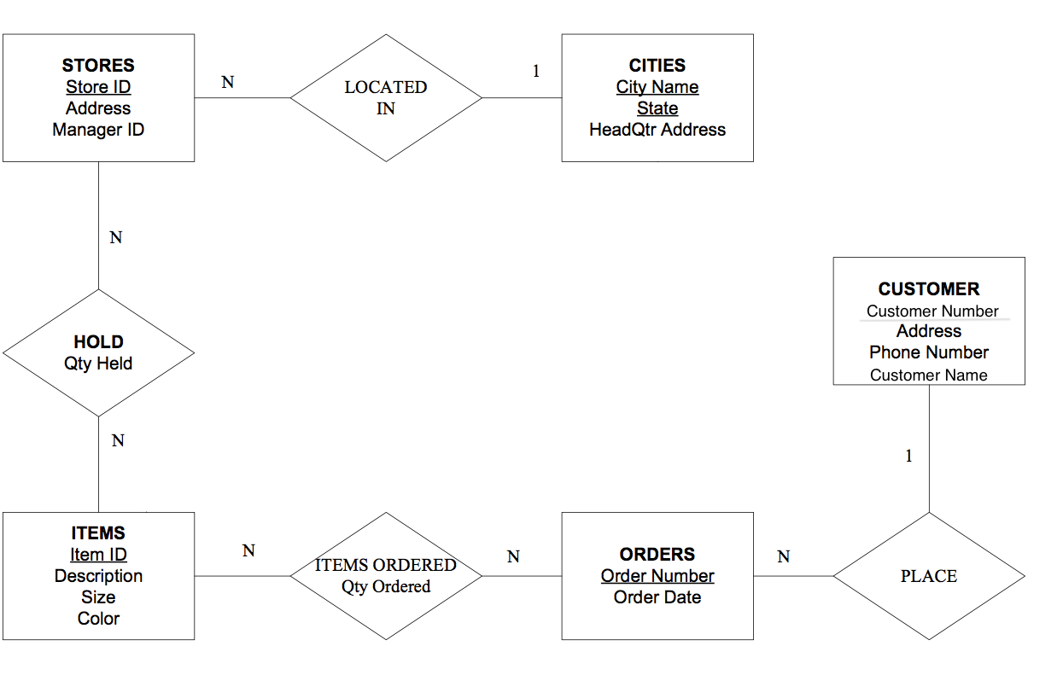
Entity Relationship Modeling: e.g., ERD for a retailer

Slide 17
Entity Relationship Modeling
Main components of ERD -- Entity Relationship Diagram
Entity type
identifiable “things”, e.g., a person, object, place or event, for which data (attributes) are collected
Relationship type
interaction between the entities
Notes:
Cardinality and Modality are the indicators of the business rules around a relationship. Cardinality refers to the maximum number of times an instance in one entity can be associated with instances in the related entity. Modality refers to the minimum number of times an instance in one entity can be associated with an instance in the related entity.
Cardinality can be 1 or Many and the symbol is placed on the outside ends of the relationship line, closest to the entity, Modality can be 1 or 0 and the symbol is placed on the inside, next to the cardinality symbol. For a cardinality of 1 a straight line is drawn. For a cardinality of Many a foot with three toes is drawn. For a modality of 1 a straight line is drawn. For a modality of 0 a circle is drawn.

Slide 18
Entity Relationship Modeling
Main components of ERD -- Entity Relationship Diagram
Cardinality
maximum number of times an instance in one entity type can be associated with instances in the related entity type
Modality
minimum number of times an instance in one entity type can be associated with an instance in the related entity type
Notes:
Cardinality refers to
Cardinality and Modality are the indicators of the business rules around a relationship. Cardinality refers to the maximum number of times an instance in one entity can be associated with instances in the related entity. Modality refers to the minimum number of times an instance in one entity can be associated with an instance in the related entity.
Cardinality can be 1 or Many and the symbol is placed on the outside ends of the relationship line, closest to the entity, Modality can be 1 or 0 and the symbol is placed on the inside, next to the cardinality symbol. For a cardinality of 1 a straight line is drawn. For a cardinality of Many a foot with three toes is drawn. For a modality of 1 a straight line is drawn. For a modality of 0 a circle is drawn.

Slide 19
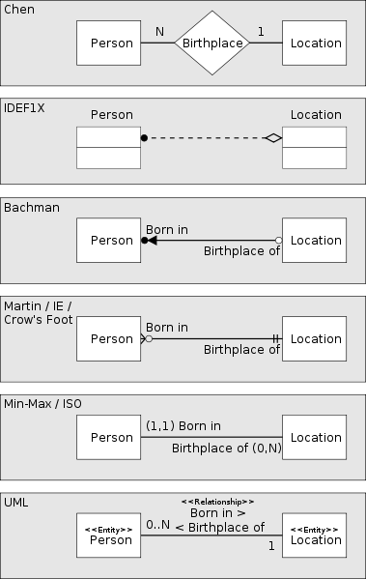
Entity Relationship Modeling
Notation
Notes:
Crow's Foot notation is used in Barker's Notation, SSADM and Information Engineering. Crow's Foot diagrams represent entities as boxes, and relationships as lines between the boxes. Different shapes at the ends of these lines represent the cardinality of the relationship.
Crow's Foot notation was used in the 1980s by the consultancy practice CACI. Many of the consultants at CACI (including Richard Barker) subsequently moved to Oracle UK, where they developed the early versions of Oracle'sCASE tools, introducing the notation to a wider audience. The following tools use Crow's Foot notation: ARIS, System Architect, Visio, PowerDesigner, Toad Data Modeler, DeZign for Databases, Devgems Data Modeler, OmniGraffle,MySQL Workbench and SQL Developer Data Modeler. CA's ICASE tool, CA Gen aka Information Engineering Facilityalso uses this notation. Historically XA Systems Silverrun-LDM (logial data model) also supported this notation.

Slide 20
Entity Relationship Modeling
Mapping natural languages to ERDs
English grammar structure | ER structure
Common noun | Entity type
Proper noun | Entity
Transitive verb | Relationship type
Intransitive verb | Attribute type
Adjective | Attribute for entity
Adverb | Attribute for relationship

Slide 21
Data Model Verification
E-R model is verified against proposed system processes
End user views and required transactions
Access paths, security, concurrency control
Business-imposed data requirements and constraints
Reveal additional entity and attribute details

Slide 22
II. DBMS Software Selection
Factors affecting purchasing decision
License cost
DBMS features and tools
Underlying model
Portability
DBMS hardware requirements
Each industry has typical use-cases
E-commerce apps: (MySQL) WAMP/LAMPServer
Enterprise apps: Oracle, SAP, etc…
Notes:
DBMS software selection is critical
Advantages and disadvantages need study
Commercial matured DBMS: costly, lock-in
Open-source: no-cost, full control, need a lot of optimization, etc…, strong technical teams…
Each industry has some typical use cases, if there is nothing special → just go for the normal use case / pattern
E-commerce: WAMP

Slide 23
II. DBMS Software Selection
For example, consider DBMS features:
Situations Where SQLite Works Well
Situations Where Another RDBMS May Work Better
http://www.sqlite.org/whentouse.html
Notes:
From technical point of view:
DBMS software selection is critical
Advantages and disadvantages need study
Commercial matured DBMS: costly, lock-in
Open-source: no-cost, full control, need a lot of optimization, etc…, strong technical teams…
Each industry has some typical use cases, if there is nothing special → just go for the normal use case / pattern
E-commerce: WAMP

Slide 24
III. Logical Design
Translates conceptual design into logical schema
Description of the structure of the database (e.g., Relational schema)
Translating entities
Create a table with the name of the Entity
There is a column for each attribute
The key in the diagram is the primary key of the table

Slide 25
III. Logical Design
Translating relationship
1-to-X:
design a foreign key on the X-side table referring to the primary key of the 1-side table
M-to-N:
create a new table with foreign keys referring to the primary keys of two entities of the relationship, plus other attributes of the relationship
Notes:
better model it as an entity with relationships (1-to-M and 1-to-N) from the two entities of the original relationship in the ERD
then apply the above (1-to-X) rule

Slide 26
III. Logical Design: e.g., schema for a retailer
Stores(Store_ID, Address, Manager ID, City Name, State)
Cities(City Name, State, HeadQtr Address)
Items(Item ID, Description, Size, Color)
Hold(Store ID, Item ID, Qty Held)
Orders(Order Number, Order Date, Customer Number)
Items Ordered(Order Number, Item ID, Qty Ordered)
Customer(Customer Number, Address, Phone Number, Customer Name)

Slide 27
IV. Physical Design
Maps objects in model to specific DBMS constructs
Data types, Indexes, Views, Transactions, Access control/authorities, etc…
Selection of data storage based on access characteristics
E.g.: for MySQL, choose InnoDB vs. MyISAM
Complicated for distributed systems / cluster databases

Slide 28
Exercises

Slide 29
Design inventory database for FairPrice retailer
The retailer has more than 230 stores and for each store, the following information need to be recorded: its postal code, street, block number, area, and phone number.
The retailer sells a wide range of products. The information of each product include the product id, its category, name and price.
The system needs to maintain the inventory information, i.e., the quantity of each product available at each store.
Notes:
Design a database for maintaining inventory data of NTUC FairPrice, the largest grocery retailer in Singapore with a network of more than 230 outlets.

Slide 30
Design inventory database for FairPrice retailer
Store postal_code
blkno
street
area
phone
Product id
category
name
price
Inventory
quantiy
N
N
Store(postal_code, street, blkno, area, phone)
Product(id, category, name, price)
Inventory(postal_code, id, quantity)

Slide 31
Hands-on
Getting started with SQLite
Populate a sample database
Execute SQL commands
See details: http://tinyurl.com/orbital14-mc3

Slide 32
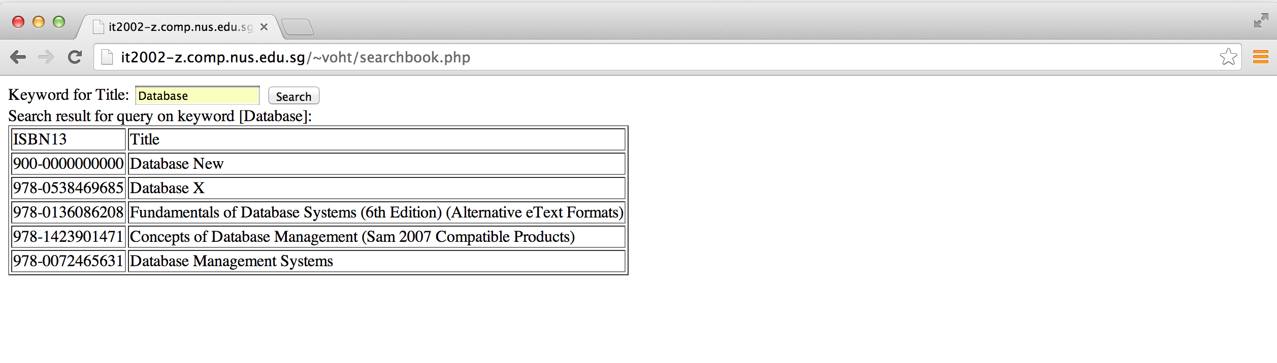
Accessing databases from web apps
PHP + Oracle
Can apply for SoC zone account !

Slide 33
Accessing databases from web apps
Accessing SQLite databases from Python, http://www.tutorialspoint.com/sqlite/sqlite_python.htm
Accessing SQLite databases from PHP, http://www.php.net/manual/en/sqlite3.open.php , http://www.tutorialspoint.com/sqlite/sqlite_php.htm

Slide 34


SQL vs NoSQL
Last year: http://tinyurl.com/orbital-sql-nosql

Slide 35

SQL vs NoSQL
Trends?
Comparison?
Use-cases?
Notes:
Particularly, I shall focus on three main points:
First, the trends that are affecting the database landscape
Second, the comparison of SQL and NoSQL
And finally, practical use-case to demonstrate the design choice between the two approach

Slide 36
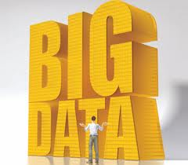

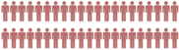

Trends disrupting database status quo
Big Data
Big Users
Cloud Computing
Notes:
So, recently, big data, big users and cloud computing are the three emerging trends that have a significant on the database technology.

Slide 37
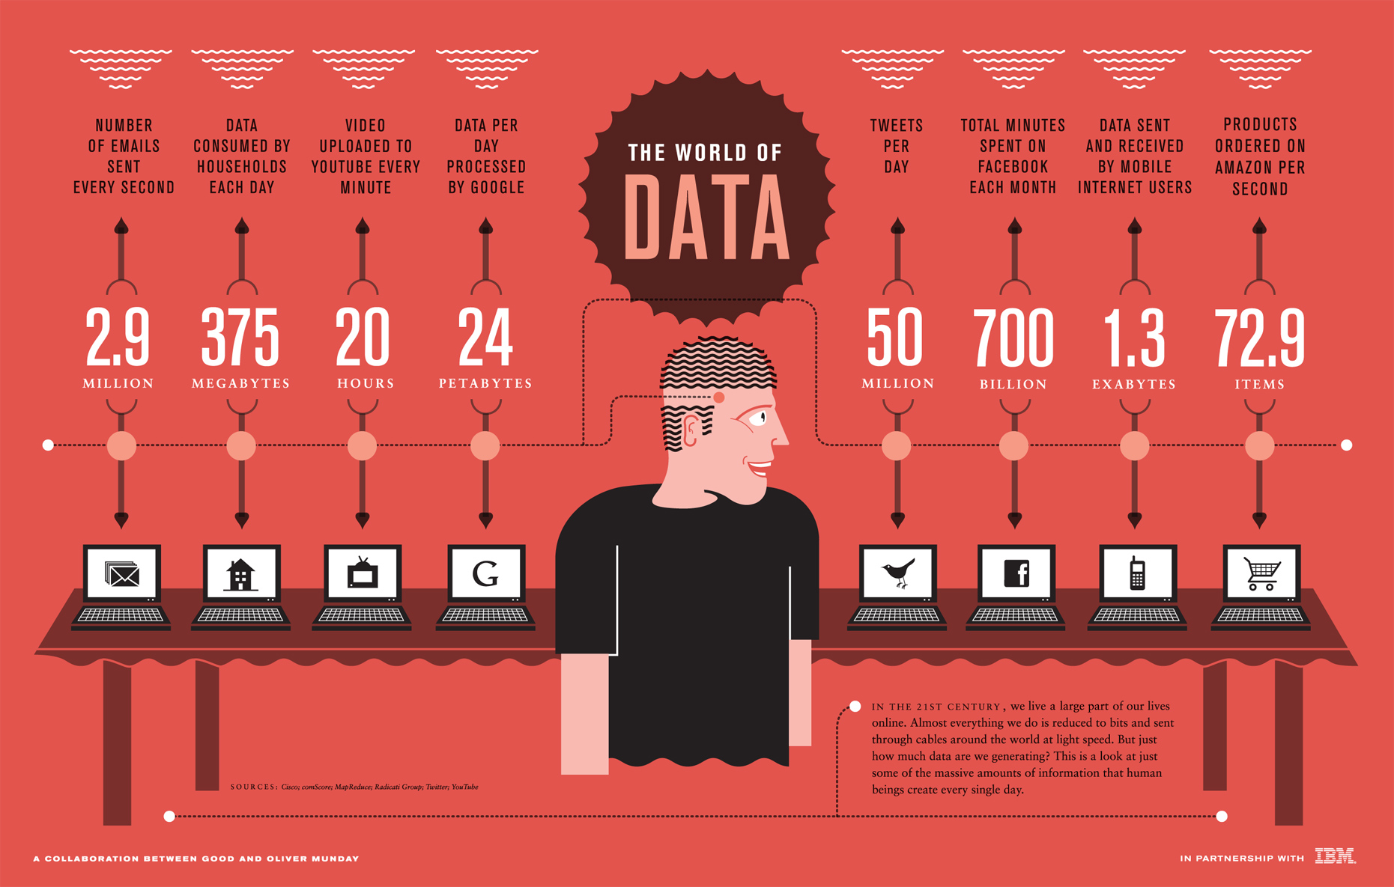
Notes:
For examples, …

Slide 38

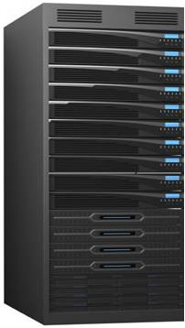
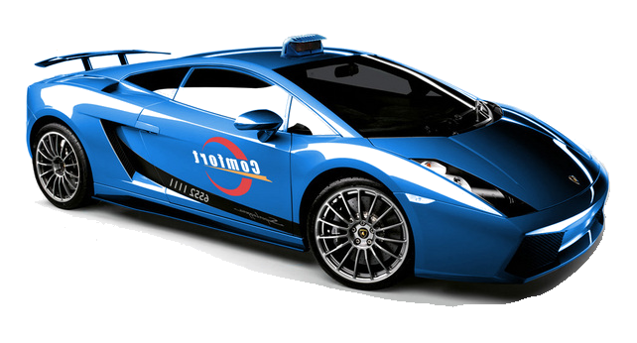

Ideal Taxi
Cloud services
Convenient
Affordable
Reliable
Notes:
To deal with the challenges of the ever increasing amount of data and users, cloud computing technology has evolved and gained fast popularity for its promising features:
Convenient – just call or click, then the service is ready to use
Affordable – no upfront cost and pay per use model
Reliable – the users do not need to care about the maintenance of hardware and software

Slide 39
SQL vs NoSQL
Comparison?
Trends?
Use-cases?
Notes:
Ok, now let’s see what SQL and NoSQL are and how they are different.

Slide 40
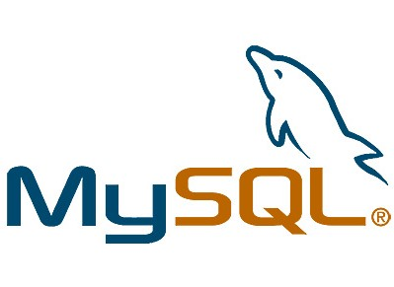

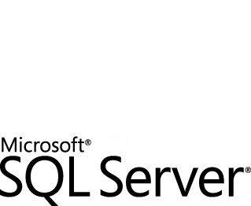

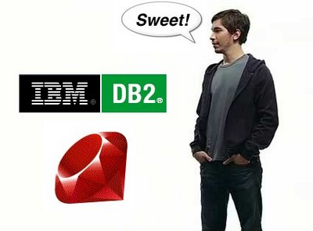
SQL Databases
Notes:
To manage the well (highly) structured data, e.g., data in an enterprise or ecommerce application, there have been a lot of standard products in the markets, ranging from open-source to commercial SQL database software.

Slide 41
SQL databases
Structured Query Language
DDL: create table/view/index
DML: transactions, join/aggregate queries
Notes:
SQL stands for structured query language
which includes Data Definition Language for creating table/view/index,
and Data Manipulation Language for running transactions and complex queries, such as join or aggregate across multiple tables

Slide 42
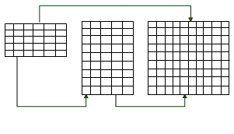
Relational data model
Customer
Accounts
Transactions
Notes:
SQL databases mainly are based on the relational data model, where data are organized into tables, and the relationship between tables can be established by defining foreign key constraint in one table referring to the primary key of another table.

Slide 43


Strict Consistency
$1000
Joe
Mary
$1000
$ 0
Customer
Accounts
Transactions
Notes:
One of the most important features of SQL database is its guarantee of strict consistency and integrity constraint.
For example, in a banking database, when joe performs a transfer to mary’s accounts, the database system guarantees that either both accounts are updated and there is no partial update in the events of hardware or software failures.

Slide 44
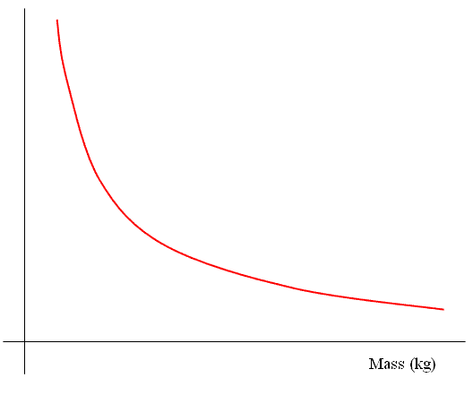
Strict Consistency
Performance
Data
Notes:
However, strict consistency does not come for free. When the data in the system grow beyond the capability of a single machines, it will need to be partitioned across machines, which adds much overhead for managing distributed txns accessing data located on different machines. That is, enforcing strict consistency over large-scale data will limit the performance of the database system.

Slide 45

Eventual Consistency
Joe
Mary
Gloria
Steve
…
Gloria
Steve
Joe
…
John
Steve
…
Notes:
Fortunately, not all applications require strictly consistency, and there is application that users don’t mind temporary inconsistent data as long as the data are guaranteed to be consistent eventually.
For instance, in a social networking application, when mary accept the friend request from joe, her friendlist is updated immediately
while joe’s friendlist could be modified at a later time.

Slide 46
Eventual Consistency
Joe
Mary
Gloria
Steve
Joe
…
John
Steve
Mary
…

Slide 47
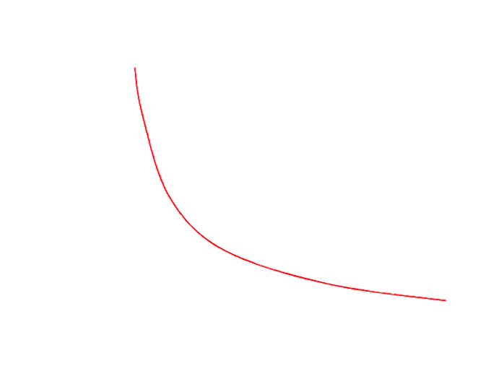
Eventual Consistency
Performance
NoSQL
Eventually Consistent
Consistent
Data
Notes:
Interestingly, eventual consistency allows for improvement of system performance, and is the main rationale behind NoSQL databases.

Slide 48
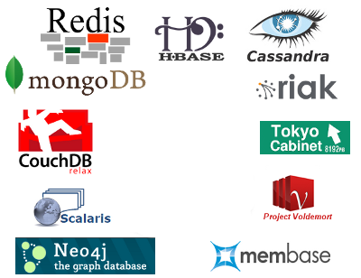
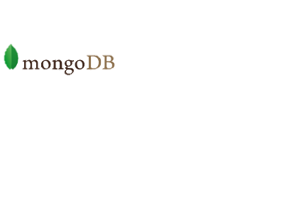

SQL Databases
No
Database products for supporting large-scale apps and data while relaxing consistency and complex queries
Key-value stores, Bigtable-like stores, Document stores, Graph databases
Notes:
NoSQL is commonly interpreted as Not-only-SQL, which are database products for supporting…
NoSQL can be classified into four major categories:

Slide 49
SQL
NoSQL
Queries
Scalability
Transactions
Management
Consistency
Schema
Notes:
So, this is a brief comparisons between SQL and NoSQL.
SQL is good at …
While NoSQL is ideal for elastic scalability, easy system management, and flexible schema…

Slide 50
SQL vs NoSQL
Trends?
Comparison?
Use-cases?
Notes:
Now let’s see in which scenarios that we should use SQL and NoSQL

Slide 51
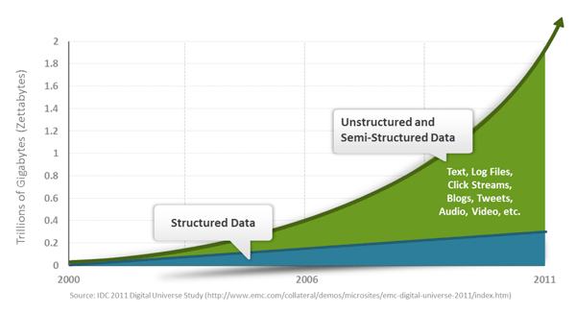
Structured vs Unstructured Data
Notes:
This figure shows the characteristics of data being generated by modern applications. As we can see, there are more and more unstructured and semi-structured data to be managed and analyzed, such as log files, click streams, blogs, tweets...

Slide 52



Structured Data
Transactions
Customer
Accounts
Notes:
For well structured data, such as data in an enterprise and ecommerce application, it can be easily managed by traditional SQL databases…

Slide 53
SQL Databases
Customer
Accounts
Transactions

Slide 54
Unstructured Data
Fewer relations
Notes:
However, for unstructured data, the graph representing the friendship relationship in a social app, there is fewer relationship between users in a very large graph

Slide 55
Unstructured Data
Fewer relations
Less need for strict consistency
Notes:
and especially less need for maintaining strict consistency all the time…

Slide 56
Use NoSQL
Notes:
In this case, NoSQL will be a good candidate for managing such data.
→ See how graph database neo4j store data and perform query.

Slide 57
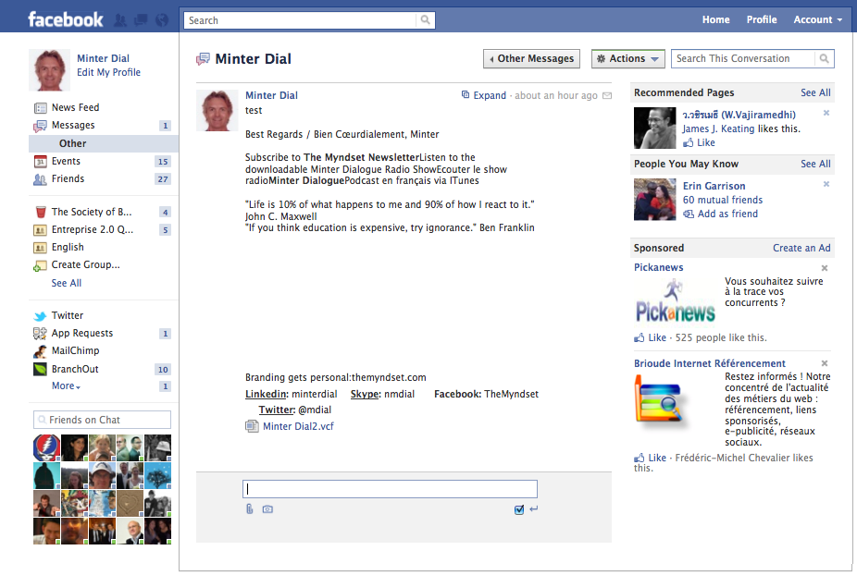
Facebook Inbox Search
Notes:
Let’s see another example, Facebook Inbox Search…

Slide 58
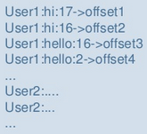
Facebook Inbox Search
Support efficient searches:
Get top N messages given userid & word
Typeahead query: given a user, get words matching prefix
Use Hbase (NoSQL)
Schema
Key: rowkey (userid), column(word), version(msgid)
Value: auxiliary info (offset of word in msg)
Data is stored and sorted by <userid, word, msgid>
Notes:
The aim of this functionality is to support efficient queries such as…
Given such requirement, the data could be organized in Hbase, a key-value NoSQL system with the key is a composite of …, and the value is ….
And the data is stored and sorted by the key.
In this way, data related to a given user and word will be clustered together, enabling efficient processing of queries.

Slide 59
SQL-NoSQL Trade-off
Trips info of clients
Manage data of Users and Trips
Users can plan zero or more trips
Typical queries:
List a user’s trips (display the trip destination name and photo)
Display a trip, along with users who planned it (we only need the user’s ID, name, and photo)
Display a trip, along with the travelling users
SQL design:
Three tables -- Users, Trips, Travels(User_Trip)
→ Each query needs expensive join across (large&distributed) tables
Notes:
Actually, there is a trade-off in the design choice between SQL and NoSQL.
Let have a look at this example…

Slide 60
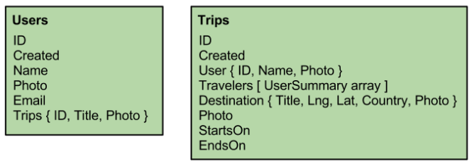
SQL-NoSQL Trade-off
Trips info of clients
NoSQL design:
De-normalize: duplicate some of the User data in the Trips table, and some of the Trip data in the Users table.
Efficient queries, but expensive update !
Update trip destination title for a trip with 3 travellers, user A, B, and C:
Update trip record, and …
Update trip summary on user A
Update trip summary on user B
Update trip summary on user C
Notes:
A NoSQL design will avoid such expensive join operations…
For instance, …

Slide 61
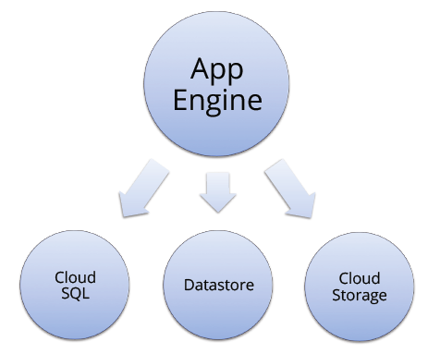
Middle Approach
Notes:
To sum up, I would say that choosing between sql and nosql is an on-going debate. And, in my opinion, the best solution is not either sql or nosql alone, but the combination of them…
More specifically, a single cloud application can manage its different data on different type of databases.

Slide 62
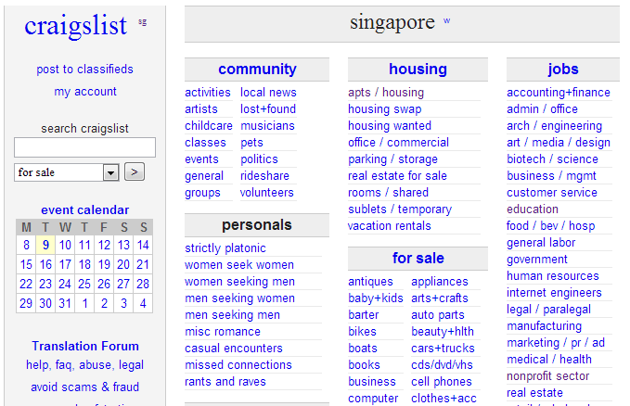
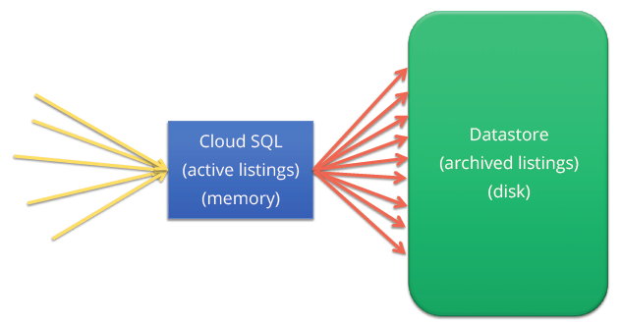
Craiglist
http://singapore.craigslist.com.sg/
Notes:
For example, in the craiglist application, where users can post listings and adverstisment, the system can maintain all active listings in a SQL database and gradually migrate old/obsolete listings to another nosql backends. In this way, we can take advantages of the approaches.

Slide 63
References
http://robvolk.com/designing-for-relationships-on-a-no-sql-database/
http://highlyscalable.wordpress.com/2012/03/01/nosql-data-modeling-techniques/
http://www.slideshare.net/brizzzdotcom/facebook-messages-hbase
http://commondatastorage.googleapis.com/io2012/presentations/live%20to%20website/306.pdf
http://www.comp.nus.edu.sg/~seer/LT2012/

Slide 64
Thank you!

Slide 65
Data analysis and Requirements: e.g., business rules for a patient appointment system
A doctor can be scheduled for many appointments, but may not have any scheduled at all. Each appointment is scheduled with exactly 1 doctor.
A patient can schedule 1 or more appointments. One appointment is scheduled with exactly 1 patient.
An appointment must generate exactly 1 bill, a bill is generated by only 1 appointment.
One payment is applied to exactly 1 bill, and 1 bill can be paid off over time by several payments. A bill can be outstanding, having nothing yet paid on it at all. One patient can make many payments, but a single payment is made by only 1 patient.
Some patients are insured by an insurance company. If they are insured, they can only carry insurance with one company.
An insurance company can have many patients carry their policies. For patients that carry insurance, the insurance company will make payments, each single payment is made by exactly 1 insurance company.

Slide 66
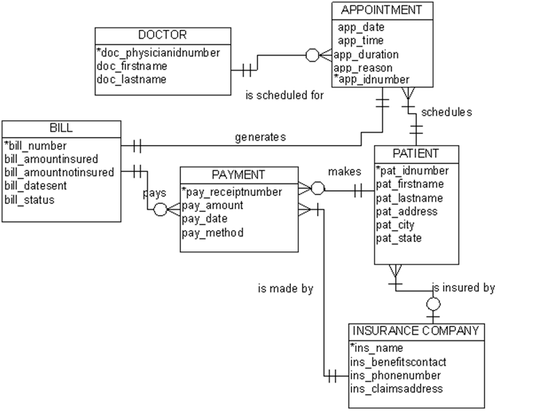
Entity Relationship Modeling: e.g., ERD for a patient appointment system

Slide 67
III. Logical Design: e.g., schema for a patient appointment system
Doctor(doc_id, doc_firstname, doc_lastname)
Patient(pat_id, pat_firstname, pat_lastname, address, city, state)
Appointment(app_id, date, time, duration, reason, doc_id, pat_id, bill_no)
Insurance Company(ins_name, address, phone, benefit_contact)
Bill(bill_no, amount_insured, amount_notinsured, date, status, app_id)
Payment(receiptno, payamount, etc., bill_no, pat_id, ins_name)

